Slide 1
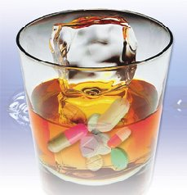



Session 8
Alcohol as a Drug

Slide 2
Learning Objectives
  Describe a brief overview of alcohol
  Identify common types of alcohols
  Describe physiological processes of absorption, distribution, and elimination of alcohol in the human body
  Describe dose response relationships that impact alcohol’s impairing effects

Slide 3
Alcohol
A family of closely-related chemicals whose molecules are made up of hydrogen, carbon, and oxygen.
H H
H C C OH
H H

Slide 4
Common Types of Alcohol
METHYL ALCOHOL
(Methanol)
ISOPROPYL ALCOHOL
(Isopropanol)
ETHYL ALCOHOL
(Ethanol)

Slide 5
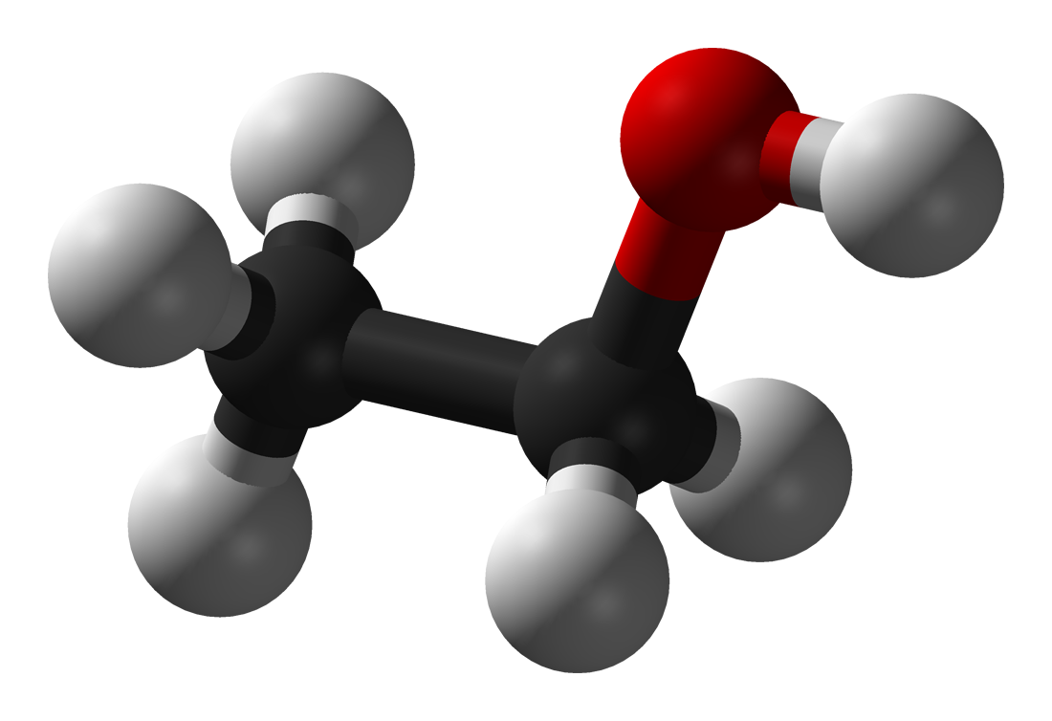
Ethanol
  Ethyl Alcohol
    (Intended for human consumption)
  Chemical Symbols:
    ETOH
    C2H5OH
H
O H
H
C
C
H
H
H

Slide 6
Production of Ethanol
FERMENTATION
  Yeast combines with sugars from fruit or grains in chemical reaction resulting in ETOH
DISTILLATION
  Fermented beverage is boiled at controlled temperature to extract and concentrate ethanol fumes

Slide 7
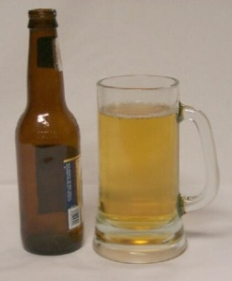
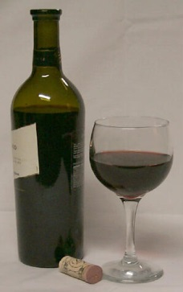
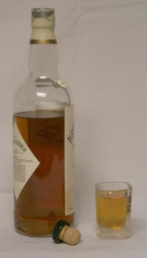
Common Drink Sizes
Bottle of Beer
  12 ounces of fluid @ 5% alcohol equals 0.60 ounces of pure alcohol
Glass of Wine
  5 ounces of fluid @ 12% alcohol equals 0.60 ounces of pure alcohol
Shot of Whiskey (80-Proof)
  1 and 1/2 ounces @ 40% alcohol equals 0.60 ounces of pure alcohol

Slide 8
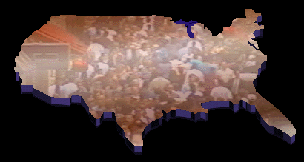
Alcohol is a CNS Depressant
Alcohol is the Most Abused Drug in the United States

Slide 9
Absorption of Alcohol
Getting the ethanol out of the stomach and into the blood.
20%
Stomach
Walls
20%
Stomach
Walls
20%
20%
Stomach
Walls
20%

Slide 10
Absorption of Alcohol
20%
Getting the ethanol
out of the stomach and into the blood.
Stomach
Walls
20%
Stomach
Walls
20%
20%
Stomach
Walls
Pylorus
20%
80%

Slide 11
Distribution of Alcohol
  Getting the ethanol into body’s tissues and organs
  Basic Principle:
    Ethanol goes wherever it finds water

Slide 12
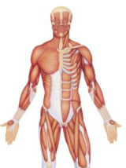
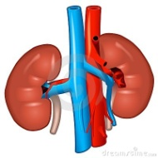
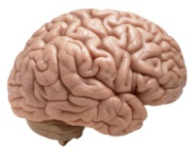
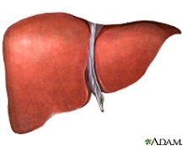
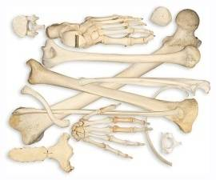
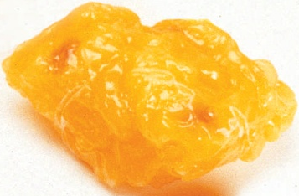
Which Parts of the Body
Have a Lot of Water?
BRAIN
LIVER
MUSCLE TISSUE
KIDNEYS
Which Parts Contain Very Little Water?
BONES
FATTY TISSUE

Slide 13
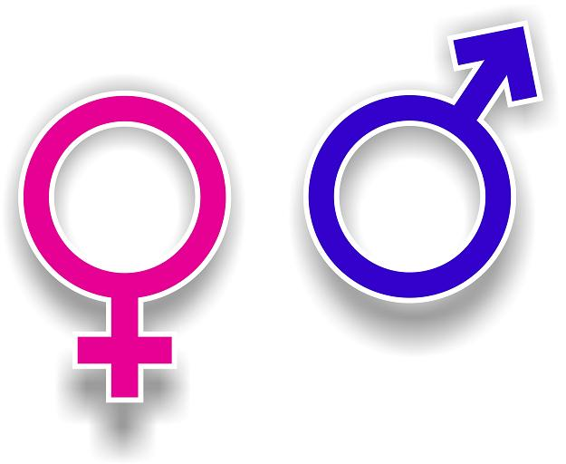
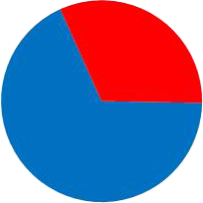

Significant Difference Between Men and Women
Average male is 68 percent water
68%
55%
Average female is 55 percent water

Slide 14
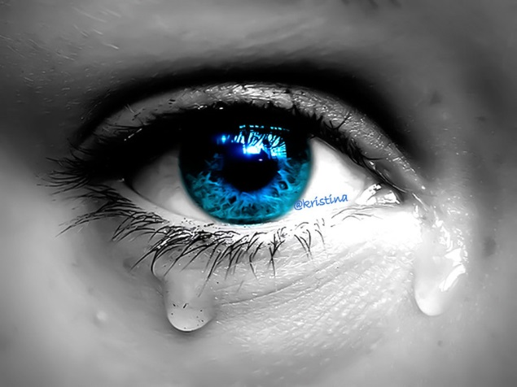
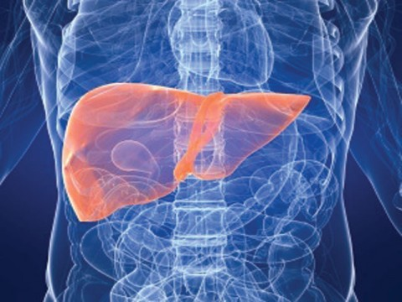
Elimination of Alcohol
Direct Excretion:
  Breath, sweat, tears, urine, etc.
  Metabolism:
  Primarily in the liver

Slide 15
Metabolism in the Liver
  Liver burns ethanol
  Process is aided by alcohol dehydrogenase enzyme
  Ultimate products of chemical reaction are carbon dioxide and water

Slide 16
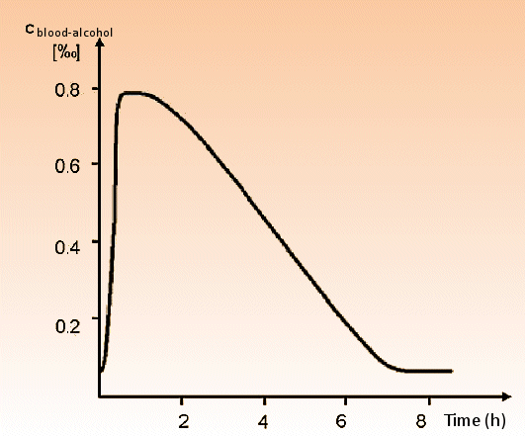
Metabolism in the Liver
Due to metabolism, the average person’s BAC drops by about 0.015 per hour

Slide 17
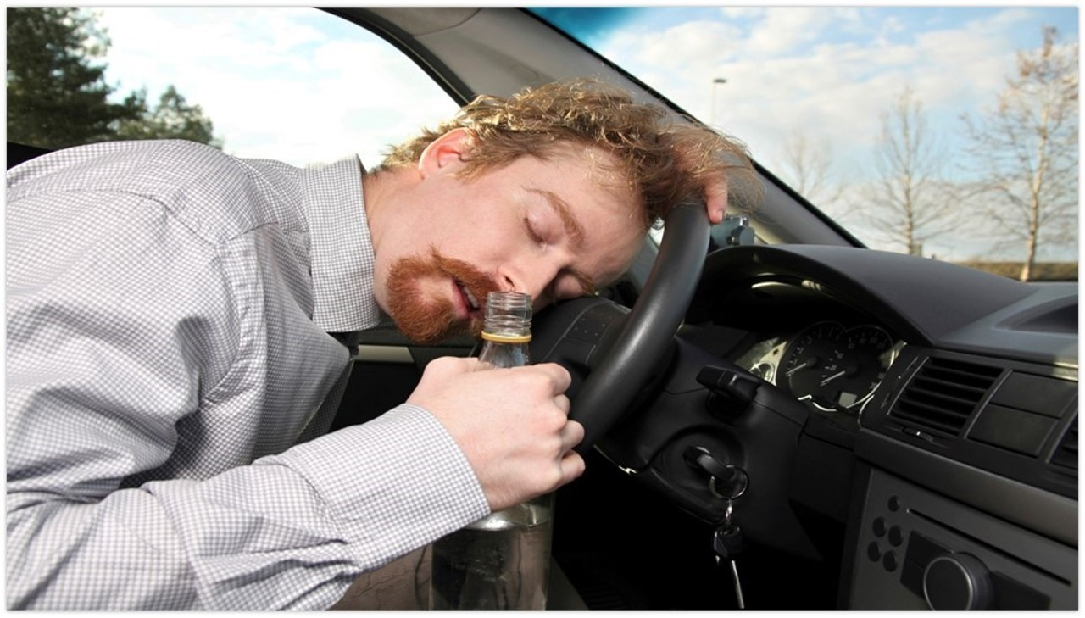
Mellanby Effect

Slide 18
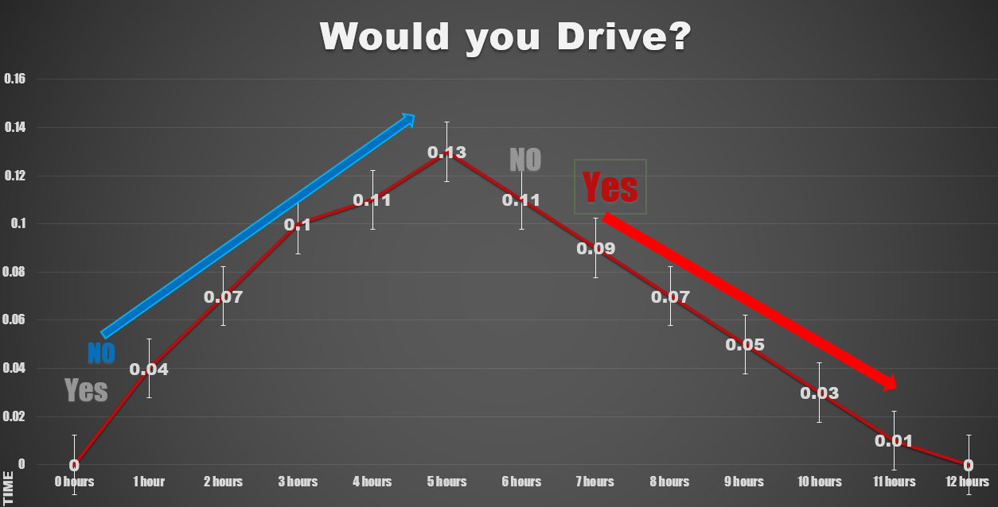
The Mellanby Effect

Slide 19
Alcohol Symptomatology
ALCOHOL | ALCOHOL
HGN | Present
VGN | Present (HIGH DOSES)
LACK CONV | Present

Slide 20
Alcohol Symptomatology
ALCOHOL | ALCOHOL
HGN
VGN
LACK CONV
PUPIL SIZE
RCTN LIGHT
PULSE RATE
BLOOD PRESS
TEMP
MUSCLE TONE

Slide 21
Alcohol Symptomatology
ALCOHOL | ALCOHOL
HGN | Present
VGN | Present (High Doses)
LACK CONV | Present
PUPIL SIZE | Normal
RCTN LIGHT | Slow
PULSE RATE | Down²
BLOOD PRESS | Down
TEMP | Normal
MUSCLE TONE | Flaccid
² May be elevated.

Slide 22
Overdose Signs and Symptoms
Alcohol Poisoning
  Abnormally Slow Breathing
  Confusion
  Conscious but Unresponsive (stupor)
Hypothermia
Pale Skin
Unconscious
Vomiting

Slide 23
Blood Alcohol Concentration
  What does it mean?
  Number of grams of alcohol found in 100 milliliters of person’s blood.
  Example: If a person has a BAC of .08, it means there is 0.08 grams of ethanol in every 100 milliliters (ml) of his or her blood.

Slide 24
Grams, Milligrams and Nanograms
  A “gram” is pretty light (it takes almost 500 grams to make one pound)
  One gram is equal to one thousand milligrams
  .08 grams are equal to 80 milligrams
  If a person has a BAC of 0.08, he or she has 80 milligrams of alcohol in every 100 milliliters of blood.

Slide 25
How much alcohol does a person have to drink to reach a BAC of 0.08?

Slide 26
More on Grams and Nanograms
  One milligram is equal to one million nanograms
  A person whose BAC is 0.08 has 800,000 nanograms of alcohol in every milliliter of blood

Slide 27
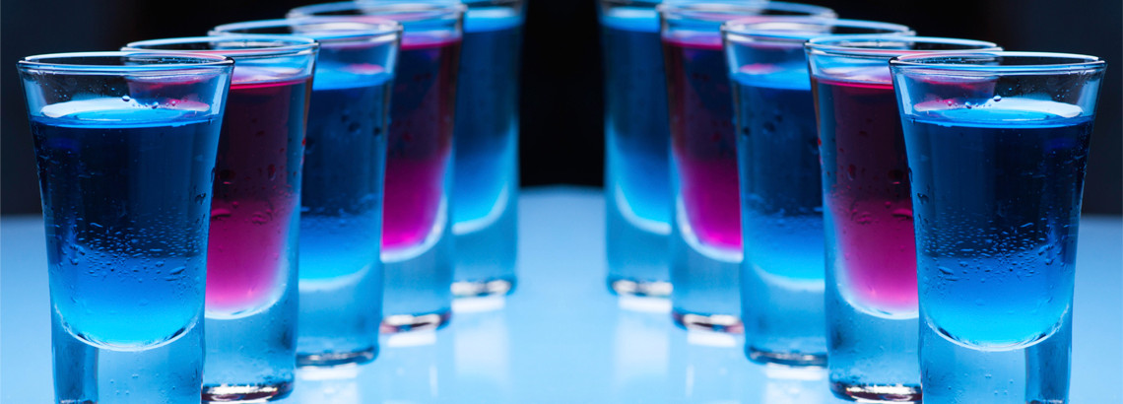
More on Grams and Nanograms
How does alcohol compare with other drugs?

Slide 28
Questions?

Slide 29
Test Your Knowledge
What is the chemical abbreviation for beverage alcohol?
What is the name of the chemical process by which beverage alcohol is produced naturally?
True or False: BAC is the number of grams of alcohol in every 100 milliliters of blood.
True or False: Pound-for-pound, the average woman contains more water than does the average man.

Slide 30
Test Your Knowledge
What do we mean by the “proof” of an alcoholic beverage?
Every chemical that is an “alcohol” contains what three elements?
True or False: Most of the alcohol a person drinks is absorbed into the blood via the small intestine.
What is the name of the muscle that controls the passage from the stomach to the lower gastrointestinal tract?

Slide 31
Test Your Knowledge
True or False: Alcohol can pass directly through the stomach walls and enter the bloodstream.
Suppose a man and a woman who both weigh 160 pounds arrived at a party and started to drink at the same time. And suppose, two hours later, they both have a BAC of 0.10. How did this occur?
In which organ of the body does most of the metabolism of the alcohol take place?

Slide 32
Test Your Knowledge
What is the name of the enzyme that aids the metabolism of alcohol?
Once a person reaches his or her peak BAC, it will drop at a rate of about _____ per hour.
True or False: It takes about 30 minutes for the average 175-pound man to “burn off” the alcohol in one 12-ounce can of beer.

